Slide 1
South West
Regional Hub
Nick Hennessy
South West Regional Hub Lead

Slide 2
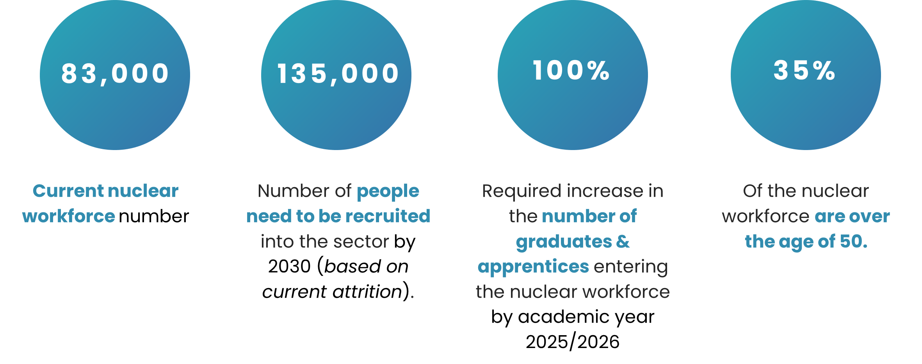
THE NUCLEAR WORKFORCE CRISIS
The UK has ambitious targets for growth in the nuclear sector, spanning across civil and defence, in order to deliver a resilient future energy system, maintain national security, and boost economic prosperity.
The key to reaching these growth targets is focusing on the workforce gap and skills deficit within the sector.
2

Slide 3
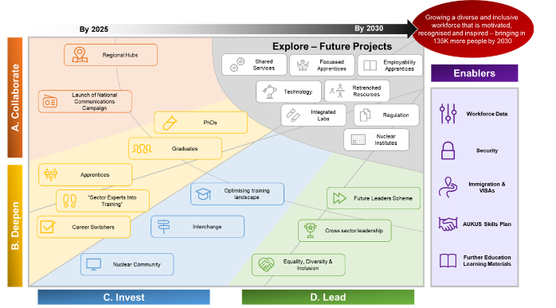
South West regional hub - aims
To support and be a key delivery mechanism for the outputs of the National Nuclear Strategic Plan for Skills (NNSPS).
South West hub will co-develop and implement interventions to support the skills demand specific to our region.
Its purpose is to drive actions from the NNSPS through enabled collaboration across the region through a range of initiatives.
3

Slide 4
SWH – motivations
The Nuclear Sector is a key contributor to the economy of the South West region and includes both Civil and Defence activities, with a significant skilled workforce in the region.
As the relevant organisations involved transition into business-as-usual, maintaining an action-oriented focus on delivery through collaboration will be critical to the Nuclear Sector at both a local and national level.
4

Slide 5
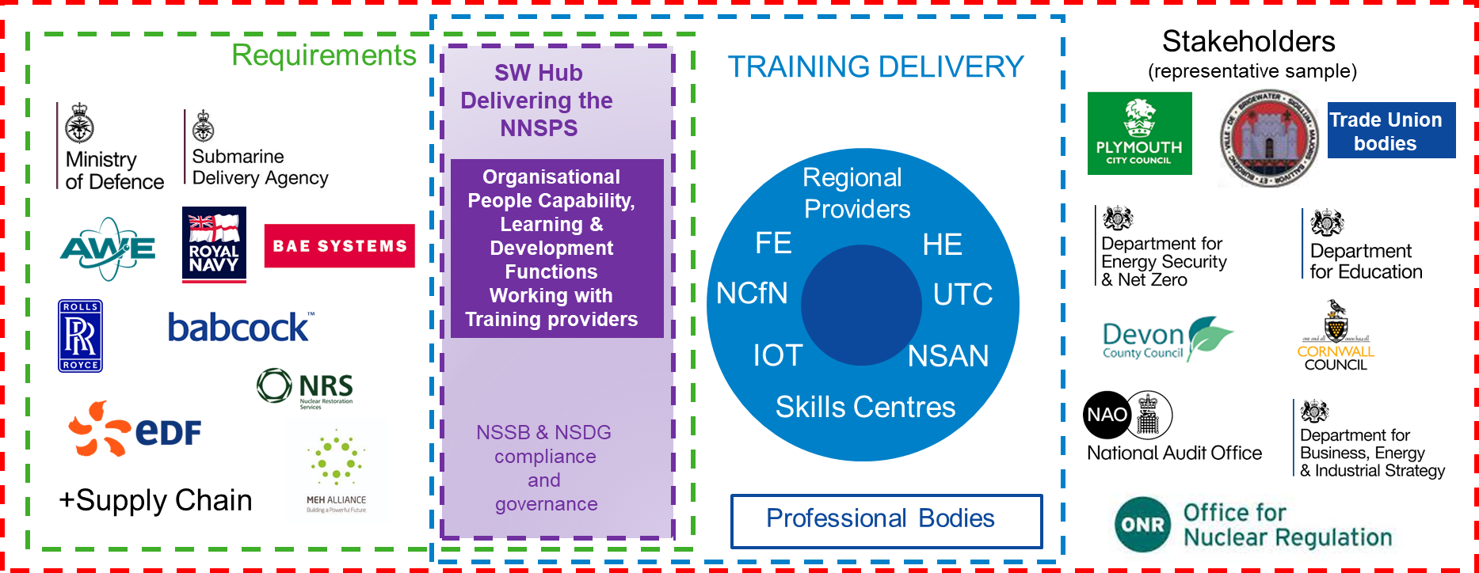

Who is involved
Stakeholders
Training Delivery
(Representative sample)
Requirements
SW Hub Delivering the NNSPS
Regional Providers
FE
HE
Organisational
People Capability,
Learning & Development
Functions
Working with
Training providers
NCfN
UTC
IOT
NSAN
Skills Centres
NSSB & NSDG compliance and governance
+ Supply Chain
Professional Bodies
5
Notes:
The Regional Hubs operate as part of a wider federated training and national hub structure to enable skills development in both capacity and capability.
The Southwest Regional Hub is made up of
Industry and Government Employers Any employer currently, or interested in, operating in the region for the provision of nuclear capability will be eligible to join the SW Hub. As a minimum, the Hub will include key regional employers (as outlined in Figure 1) Other employers, particularly SMEs will be actively encouraged to participate.
Supply Chain Employers’ supply chains will be actively encouraged to participate where outputs are aligned to the delivery of nuclear capacity and capability.
Academia / Training Providers Whilst City College Plymouth and Bridgewater and Taunton College are recognised to be the anchor academic partners, any training provider with the ability or intent to deliver training solutions in support of nuclear skills or skills for nuclear will be encouraged to join the SW Hub.
Stakeholder Bodies Stakeholder bodies are those that have a responsibility in the delivery of nuclear capability (civil and defence). The nature of those bodies may vary but are likely to include governance, compliance and standards. These bodies may represent departments of state or other government organisations. A key stakeholder is likely to be existing regional fora, such as Institutes of Technology, Chambers of Commerce, Local Authorities
It incorporates significant Civil and Defence Nuclear activity. This includes submarine maintenance, repair, overhaul and disposal; civil new build, commissioning, operation and decommissioning; nuclear weapon programmes; decommissioning and nuclear waste management; and supporting engineering and other functions
Membership lists are not exhaustive as the Southwest Hub will ensure that the right organisations are engaged at the appropriate time.

Slide 6
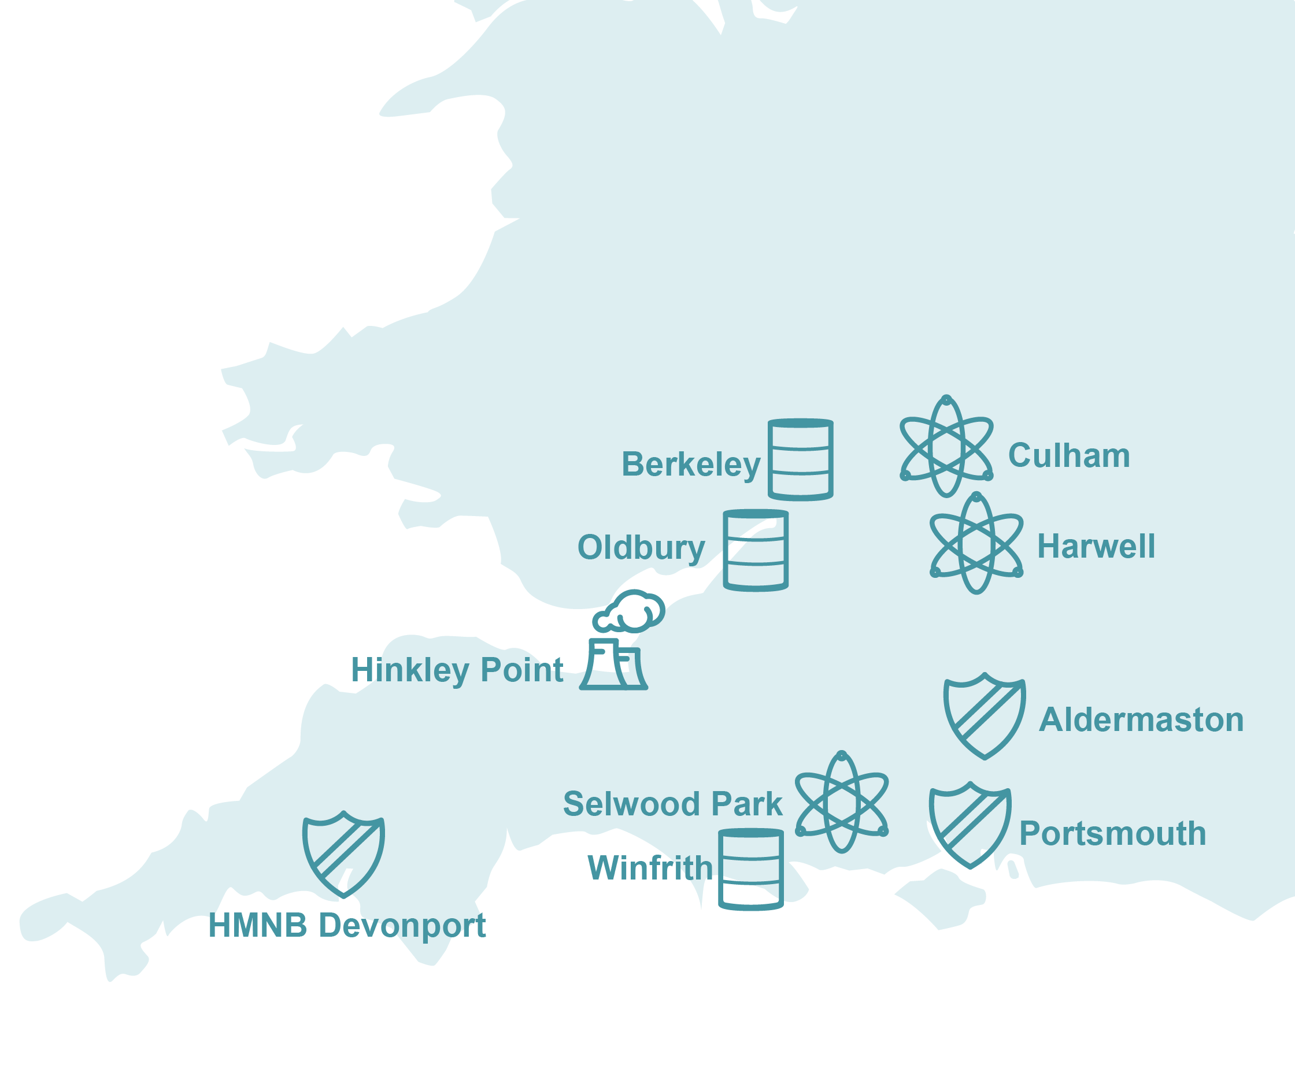
SWH – who is involved
Geographically and economically diverse regional profile
Blend of civil and defence nuclear
Encompasses:
  Cornwall
  Devon
  Somerset
  Gloucestershire
  Dorset
  Wiltshire
  Hampshire
  Berkshire
  Oxfordshire
6

Slide 7
How we’ll achieve our aims
Deliverables:
Reduced recruitment and retention costs, and attrition by poaching
Reduction in social mobility cold spots through a highly skilled workforce
Increase in use of local skilled populations and reduction in reliance on transient labour
Increased resilience in critical nuclear skills, with reduction in reliance on contingent labour in niche roles such as safety cases
National Nuclear Strategic Plan for Skills
SW Hub delivers:
Demand / supply optimisation
Optimised training landscape
Common course
Delivery mechanism for NNSPS
Works with stakeholders etc
Babcock/ CCP Engineering & Nuclear Skills building (part of Babcock Skills Academy – first physical step in driving outcomes
City College Plymouth – member of hub but also key provider to Babcock etc
SW hub team:
Chair
Seconded lead (PM)
CEO empowered member representation
Bridgwater & Taunton College – member of hub but also key provider to EDFetc
Other providers HE & FE – member or spoke member of hub
7
Notes:
A stakeholder map and communication plan to be developed and updated regularly.
With dedicated support of the management of the Hub funded via the NSDG, all member representation shall be entirely self-funded.
Funding for specific activities will be on a case-by-case basis and agreed by members.
Be accountable to the Nuclear Skills Delivery Group (NSDG).
Key stakeholders and decision makers will be required to attend a quarterly Steering Group. This will be bolstered by monthly Working Group, with appropriate appointed leads, attended and supported by required SMEs from within those stakeholders’ organisations.

Slide 8
SWH – how we’ll achieve our aims
An outcome based plan, informed by the hub and managed by the lead.
Adopt values including equality, diversity and inclusivity, with collaboration at the heart of the way we work.
Assure quality of provision through a network for accredited training providers.
Support the development and retention of skills in the region and will complement and accelerate existing activity.
It is not intended as a mechanism to remove responsibility or accountability for the development of SQEP from parties where contractual requirements exist. By defining the boundary in this way, it incorporates significant Civil and Defence Nuclear activity.
Implement interventions to support the skills demand specific to our region.
8
Notes:
A stakeholder map and communication plan to be developed and updated regularly.
With dedicated support of the management of the Hub funded via the NSDG, all member representation shall be entirely self-funded.
Funding for specific activities will be on a case-by-case basis and agreed by members.
Be accountable to the Nuclear Skills Delivery Group (NSDG).
Key stakeholders and decision makers will be required to attend a quarterly Steering Group. This will be bolstered by monthly Working Group, with appropriate appointed leads, attended and supported by required SMEs from within those stakeholders’ organisations.

Slide 9
South West Regional Hub
Our Charter

Slide 10
Why does the SWH exist?
‘The demand for Nuclear skills is set to grow rapidly over the coming decades. Nationally, 80% of employers in the nuclear sector state that they are experiencing talent shortages, indicating that current demand outstrips supply for skills, with employers finding it hard to fill posts. This challenge will increase as demand grows, requiring immediate action.’
Problem statement
Established under the Nuclear Skills Taskforce (NSTF), the Regional Hubs have been designed to support, and be a key delivery mechanism for the outputs of the National Nuclear Strategic Plan for Skills (NNSPS).
Objective
Providing an outcome based plan, informed by the hub and managed by the lead.
Adopt values including equality, diversity and inclusivity, with collaboration at the heart of the way we work.
Assure quality of provision through a network for accredited training providers.
Support the development and retention of skills in the region and will complement and accelerate existing activity.
Value

Slide 11
SWH Puprose, Vision, Mission & Values
Our purpose is to drive actions from the National Nuclear Strategic Plan for Skills through enabled
collaboration across the region through a range of initiatives.
Vision | To provide everyone an opportunity to access work within the Nuclear sector in the South West, enabling delivery of the region’s Civil and Defence Nuclear commitments
Mission | Creating a collaborative approach to the identification and realisation of benefits and outcomes against the Nuclear skills challenge in the South West region, whilst enabling prioritisation to our strategic goals; reducing recruitment costs, reduction in social mobility cold spots, increase in use of local skilled populations, increased resilience in critical nuclear skills
Values | Integrity – transparent, honest and unbiased Trust – supporting and empowering others Collaboration – we are stronger when we work together Innovation – creative solutions which challenge, adapt, evolve and improve Equality, diversity and inclusivity – embracing our differences, including beliefs, abilities, preferences, backgrounds, values, and identities.

Slide 12
South West Regional Hub
RASCI

Slide 13
SWH RASCI
Governance tier | Commitment | Who
Steering group – responsible for plan (outcomes), escalations resolution, strategy flow down, delegated authority to make change decisions to regional plan | Convened quarterly – 3 hours | Chair: Collette McMullen Facilitator: Nick Hennessy SWH employing organisation rep SWH anchor institutions SWH chair and lead
Delivery group (M) – accountable for delivery of the plan (outputs), review progress and provide assurance to the steering group that the forward programme of work can be delivered (within an informed agreed level of risk). | Convened monthly – 2 hours | Chair: Collette McMullen Facilitator: Nick Hennessy SWH employing organisation rep SWH provider institutions SWH chair and lead SWH stakeholder groups
Delivery group (W) – supporting delivery of progress and control for planned actions/outputs | Convened weekly – 30 mins | Chair: Nick Hennessy SWH employing organisation SWH provider institutions SWH stakeholder
Consulted group (AH) – provide insight to deliverables (outcomes and outputs) outputs as and when required | Consultation on an ad hoc basis | SWH provider institutions SWH stakeholder groups SWH supply chain
Informed group (AH) – informed about progress of plan delivery | Information provided in line with communication plan and ad hoc activity | SWH provider institutions SWH stakeholder groups SWH supply chain
R
Responsible: Role responsible for the deliverable in their organisation (cannot delegate)
Accountable: Role that collaborates to deliver the NNSPS plan (can delegate)
A
Support: Role that provides assistance to whoever is responsible for the deliverable
S
Consulted: Role provides information that is input to the deliverable
C
Informed: Role kept informed about the progress of the deliverable
I

Slide 14
South West Regional Hub
Goals and objectives

Slide 15


SWH Goals & Objectives 2025-26 (draft)
Comms
Curriculum delivery
Destination nuclear benefit realisation reporting
Increase click rates, recruitment conversions, inform SW campaign
Deliver SW regional specific comms strategy (via Destination Nuclear)
Act as conduits between skills initiatives in the region to foster collaboration
Support RPC (role, pathway and curriculum) workstream
Support provider coordinator body initiative – target outcome TBC
Delivery of (N) demand driven training
Deepen
Framework
Strategic workforce planning
Pipeline development
Employer tiger team to identify priority areas and scenario modelling e.g. SMRs
Collaborate with STEM futures programme to enable (N) secondment opportunities in each employer
Collaborative campaigns to support short and medium term gaps
Nuclear STEM outreach delivered linked to each employer
DWP collaboration – connect all employing organisations to DWP, place (N) entry level applicants
Sponsorship and bursaries- Identify demand in employing organisations
Remote careers fair
Collaborate
Deepen

